Slide 1
Image Analytics

Slide 2
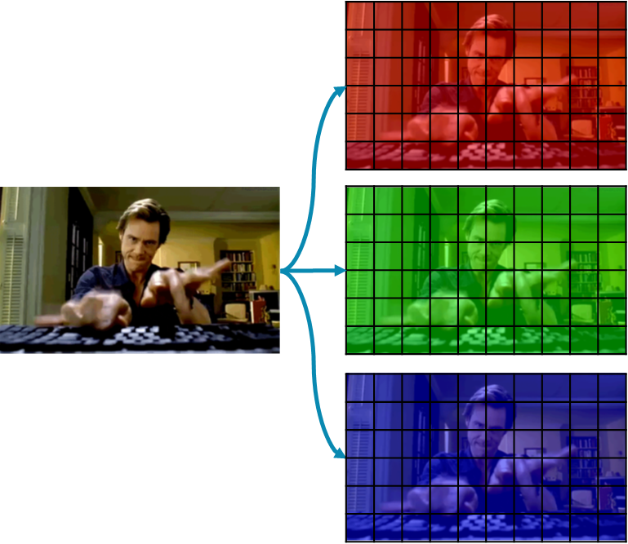
Review Image Data
Image data is 3D tensors
One image instance is one 3D tensor
Each element in the tensor represents the magnitude of the corresponding pixel at the width/height location and color channel
Need preprocessing to be usable in regular models (regression, forest, SVM, etc.) or need specific neural architectures like Convolutional Neural Networks (CNN)
5 | 1 | 3 | 8 | 9
1 | 0 | 0 | 8 | 1
0 | 7 | 5 | 3 | 1
8 | 2 | 5 | 9 | 8
5 | 1 | 3 | 8 | 9
1 | 0 | 0 | 8 | 1
0 | 7 | 5 | 3 | 1
8 | 2 | 5 | 9 | 8
5 | 1 | 3 | 8 | 9
1 | 0 | 0 | 8 | 1
0 | 7 | 5 | 3 | 1
8 | 2 | 5 | 9 | 8

Slide 3
Image Processing
Unlike tabular data which need several processing steps (e.g. standardization, class encoding, imputation), image data has the following steps
Resizing the images – depending on how we collect data, images may come in different sizes (resolutions). On the other hand, analytical models need their input in uniform size. Resizing may include the following processes
Resize the image to be smaller
Pad the image to fit certain aspect ratio
Converting between image format (RGB, grayscale, etc.)
Normalizing the pixel values. Different from standardization, we do not need to determine the mean and standard deviation of data in this case. All pixel values are from 0 to 255, so we simply divide everything by 255

Slide 4
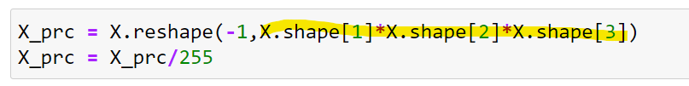
Modeling Image Data with Regular Machine Learning Techniques
Image data is still data and can be modeled with techniques we have learned so far. However, they need to be converted to 1D vector (flattened) to be usable by those models
After that, any model can solve the task (regardless of how inefficient or inaccurate)

Slide 5
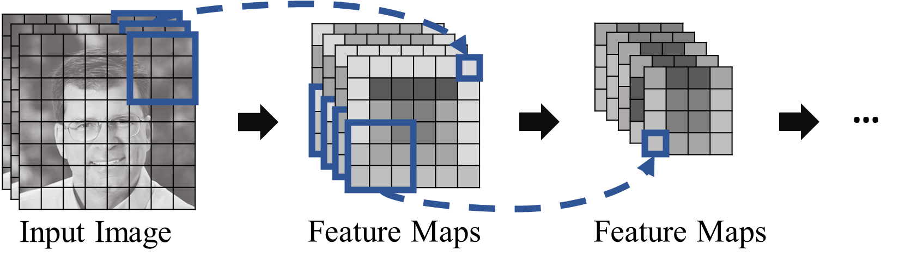
Convolutional Neural Network
Is a specific family of deep neural networks that are designed for image data
Utilize a set of filters that slide across the input image to learn different features in the image

Slide 6
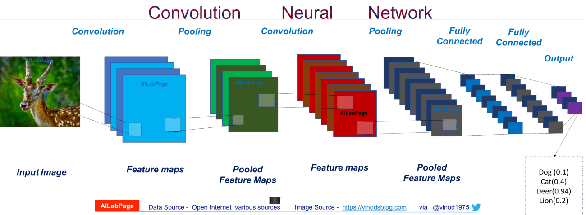
https://vinodsblog.com/2018/10/15/everything-you-need-to-know-about-convolutional-neural-networks/

Slide 7
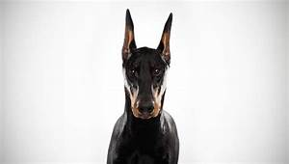
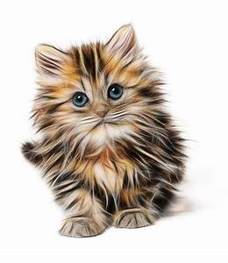
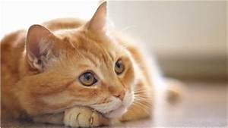
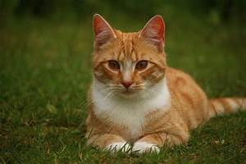
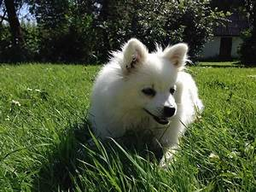
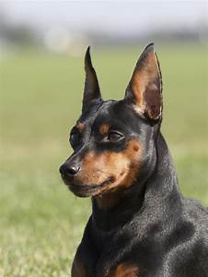
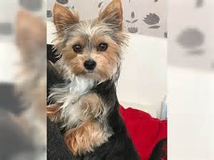
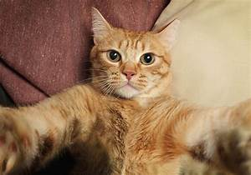
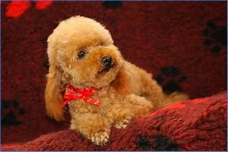
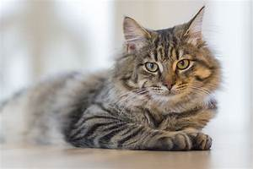
Python Example
We will try to classify images of dogs and cats
Given an image, predict/label whether the animal in the image is a dog or a cat
Images are provided in two different folders

Slide 8
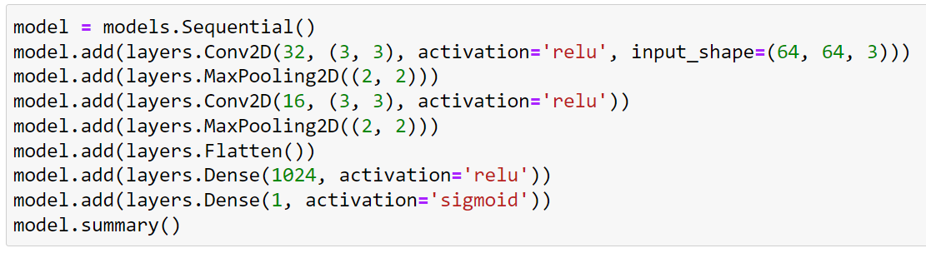
CNN in Python
Requires the package TensorFlow with is available in AWS and Azure (there are other packages such as PyTorch but we will focus on TensorFlow)
Size of the input images. We transformed data to 64x64 with colors, so input shape is 64x64x3. Only need to be specified in the first Conv2D layer
A set of Conv2D and MaxPooling layer. Can be repeated as many times as needed. More layers mean more learning capabilities but also more difficult to train
Flatten the image representation for regular neural network layers
Regular neural network layer, can also be repeated as many items as needed
Regular neural network layer, can also be repeated as many items as needed
Output layer. We are working on binary classification (dog or cat)

Slide 9
Additional Reading
Convolutional Neural Network
https://www.ibm.com/cloud/learn/convolutional-neural-networks
https://www.tensorflow.org/tutorials/images/cnn

